Slide 1
Linux Commands and File management

Slide 2
Basic Commands
who
Shows who all are logged into the current system
Whoami
shows the current user name
pwd
Shows which directory you are in or current working directory
cd
Change directory
ip addr show
Shows the current IP configuration

Slide 3
Basic Commands (Continued)
free –m
shows the system memory status and utilization
df –h
shows the available disk space
nmcli connection show
shows the active network connections
findmnt
shows mounted file system
history
shows command history / previously run command by the user

Slide 4
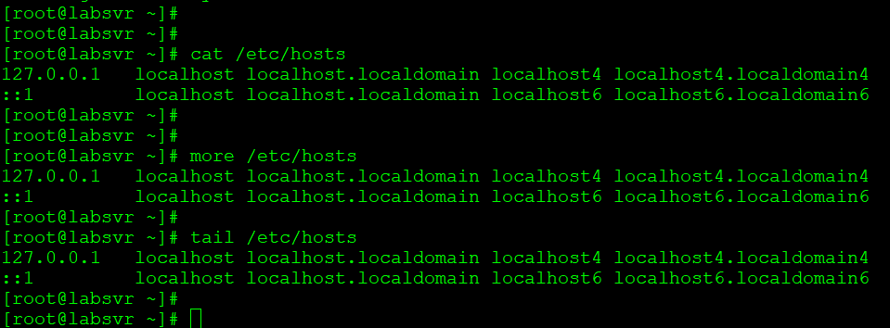
File management commands/tools/utilities
cat
Concatenate/read
more
Parse read input/file
less
page by page read
tail
Read last part of the file

Slide 5
The List Command
Useful options for the “ls” command:
ls -a List all file including hidden file beginning with a period “.”
ls -ld * List details about a directory and not its contents
ls -F Put an indicator character at the end of each name
ls –l Simple long listing
ls –lh Give human readable file sizes
ls –lS Sort files by file size
ls –lt Sort files by modification time

Slide 6
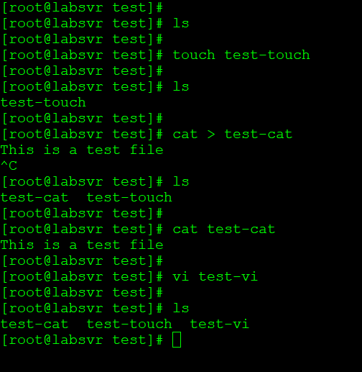
Creating a file
touch
Creates/changes file time stamp
cat
Concatenate/read
mkdir
Create a directory

Slide 7
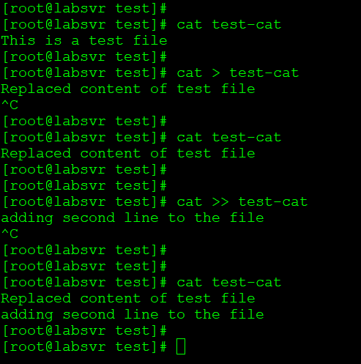
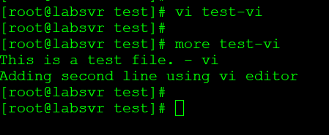
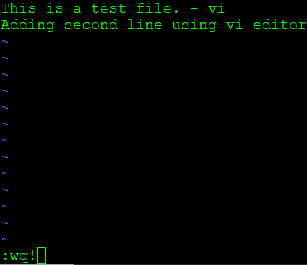
Edit/Append/Replace content of a file
cat >
cat >>
vi
vim
nano
emacs

Slide 8
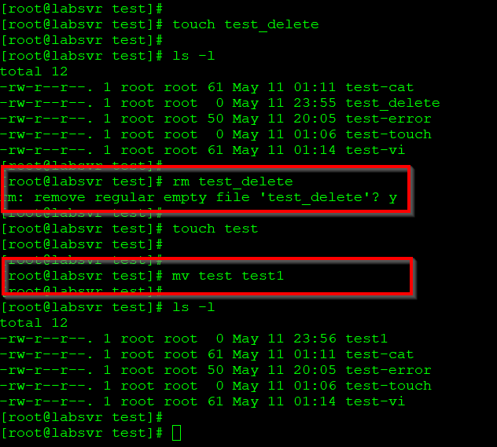
Delete/remove, move a file
rm
Remove file/files
rmdir
Remove directory
mv
Move/rename file

Slide 9
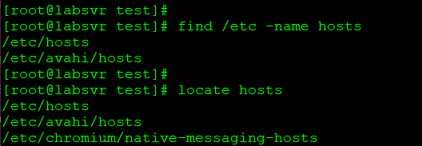
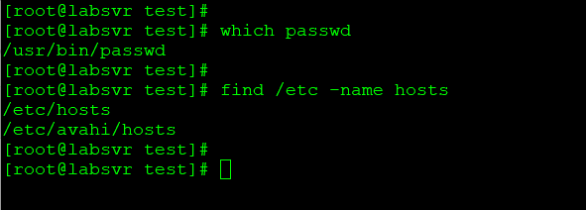
Finding files
ls
find
which
locate
Note:
Run ‘updatedb’ if locate is not working

Slide 10
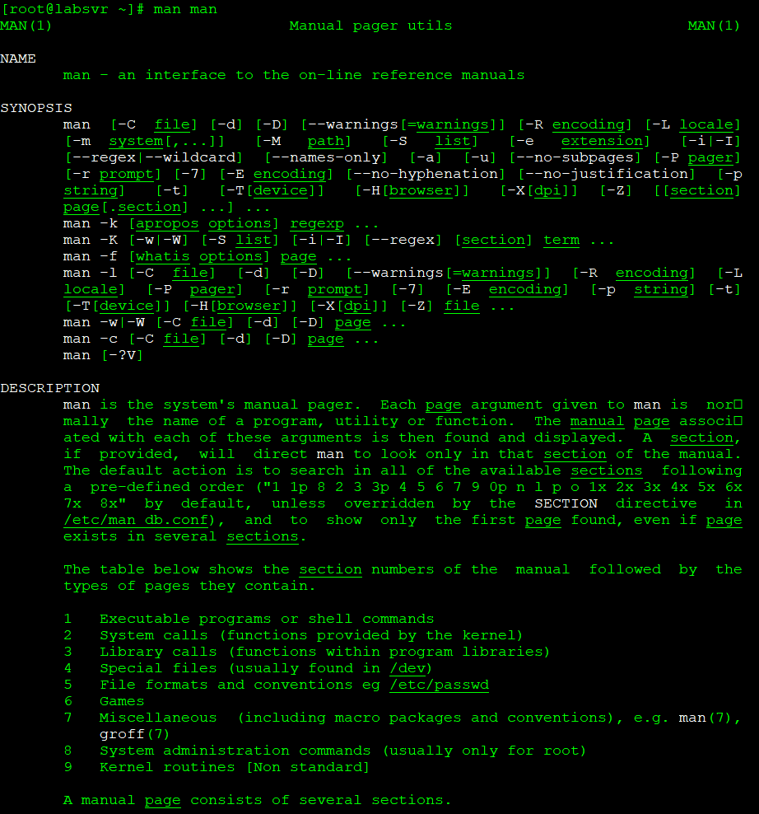
Man Pages (Help Page)
man command/utility
Shows the command help. All details about the command will be displayed.
Example:
man ls
man man

Slide 11
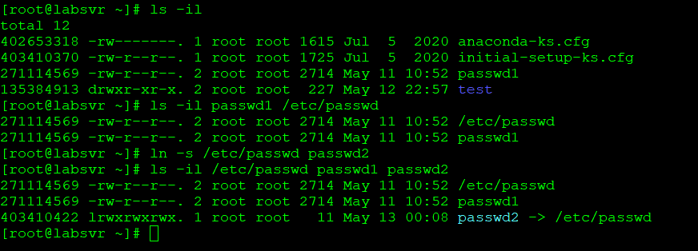
Links hard and symbolic links
Hard link:
ln /etc/passwd passwd1
Symbolic link:
ln –s /etc/passwd passwd2

Slide 12
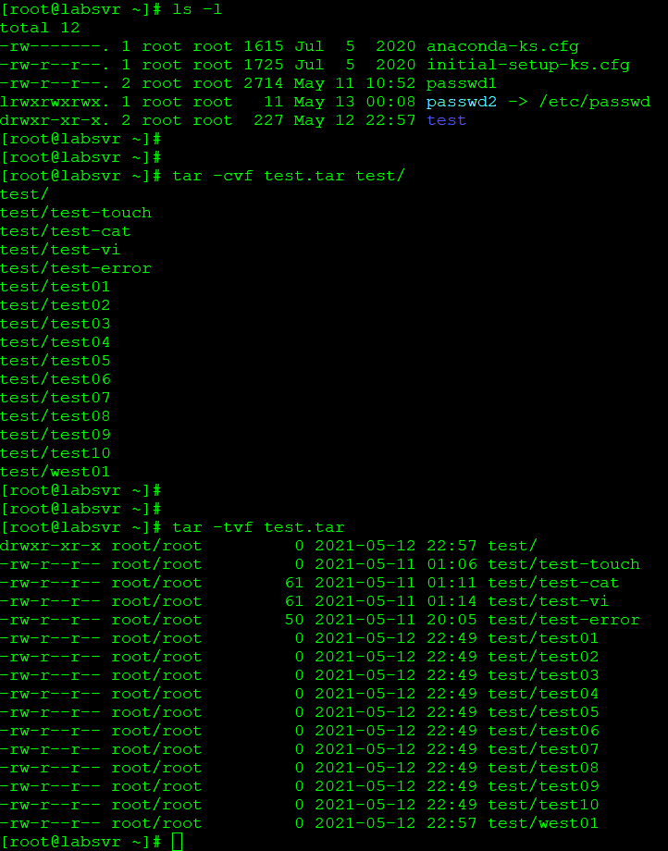
Zip/Archive
Create tar file:
tar –cvf test.tar /root/test/
Extract tar file:
tar –xvf test.tar
List tar file content:
tar –tvf test.tar

Slide 13
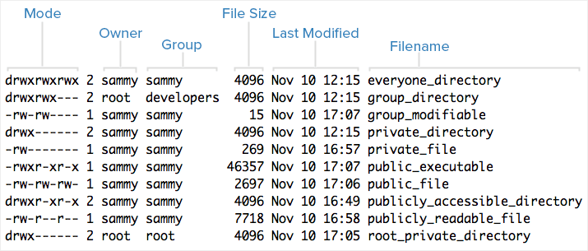
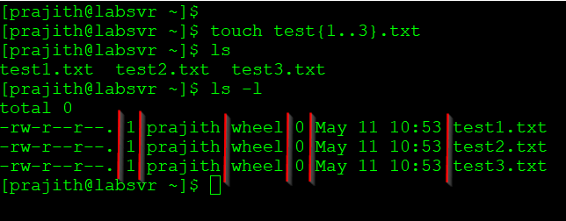
Understanding ls long listing (ls –l)
-rw-r--r- permissions
1 : number of linked hard-links
prajith: owner of the file
wheel: which group this file belongs to
0: size
May 11 10:53 : modification/creation date and time
test1: file/directory name

Slide 14
File Permissions
-rw-------:
A file that is only accessible by its owner
-rwxr-xr-x:
A file that is executable by every user on the system. A “world-executable” file
-rw-rw-rw-:
A file that is open to modification by every user on the system. A “world-writable” file
drwxr-xr-x:
A directory that every user on the system can read and access
drwxrwx---:
A directory that is modifiable (including its contents) by its owner and group
drwxr-x---:
A directory that is accessible by its group

Slide 15
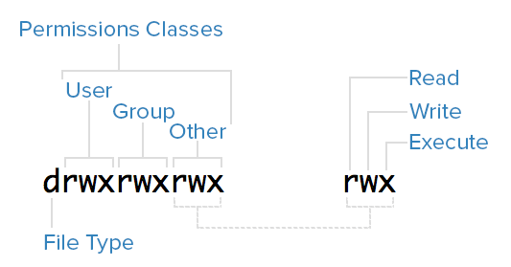
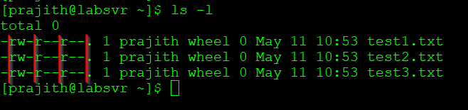
File Permissions
Read (r): The read permission allows the user to open the file and read its contents.
Write (w): The write permission allows the user to modify or change the contents of the file.
Execute (x): File execute permission
l,d,c in the first field stands for link, directory and character file respectively

Slide 16
chmod common option
000 -- 0 -- _ _ _
001 – 1 -- _ _ x
010 – 2 -- _ w _
011 – 3 -- _ w x
100 – 4 -- r _ _
101 – 5 -- r _ x
110 – 6 -- r w _
111 – 7 -- r w x

Slide 17
Input and Output Redirection
Output Redirection: > , >>
example: ls –l > test.txt
some_program >> test.txt
Input redirection: < , <<
example: mail –s “test mail” admin@lab.com < test.txt
Error redirection: 2>, 2>>
example: some_command 2>
Pipe: |
example: ls –l | more

Slide 18
Filters
Filters are commands that alter piped redirection and output. Note that filter commands are also standard Linux commands that can be used without pipes.
find:
find returns files with filenames that match the argument passed to find.
grep:
grep returns text that matches the string pattern passed to grep.
tee:
tee redirects standard input to both standard output and one or more files.
tr:
tr finds-and-replaces one string with another.
wc:
wc counts characters, lines, and words.

Slide 19
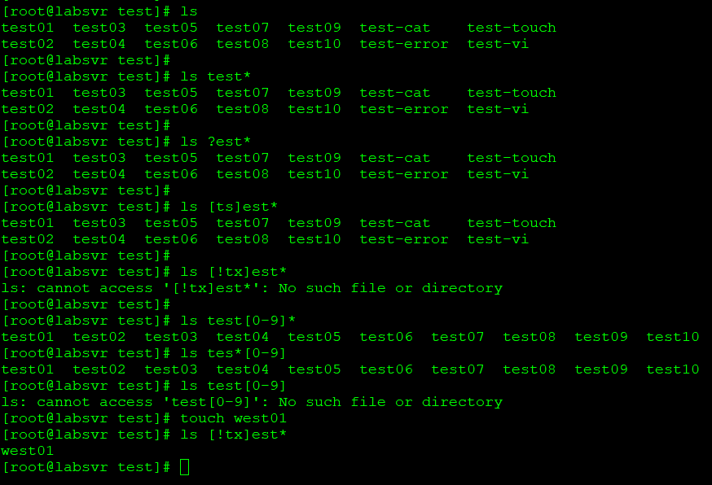
Wildcard Characters
ls test*
ls ?est
ls [ts]est
ls [!ts]est
ls test[0-9][0-9]

Slide 20
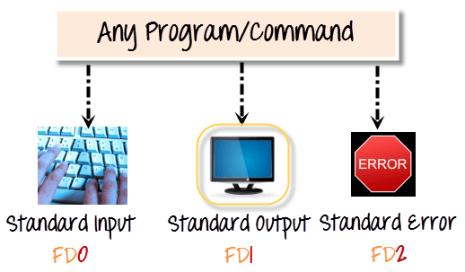
File Descriptor
These are three default files named below which are also identified by the shell using file descriptor numbers:
stdin or 0 – it’s connected to the keyboard, most programs read input from this file.
stdout or 1 – it’s attached to the screen, and all programs send their results to this file and
stderr or 2 – programs send status/error messages to this file which is also attached to the screen

